Slide 1

INFormation retrieval IN dbms
BY - TECH CYNICS TEAM MEMBER:-
LEKHA VARSHA , SUDARSHAN
VISHWA , PRAVEEN , GOKUL

Slide 2
Agenda
IR
INFORMATION RETRIVAL CONCEPT
INTRODUCATION TO INFORMATION RETRIEVAL
CHARACTERIZATION OF INFORMATION RETRIVAL
COMPARISON
DATABASE SYTEM
AND
INFORMATION RETRIVAL SYSTEM
MODES OF INTERACTION
RETRIEVAL
BROWSING
GENERIC IR FRAME WORK
IR PROCESSING DIAGRAM
IR FRAMEWORK

Slide 3
IR (INFORMATION RETRIEVAL)
Information retrieval is the process of retrieving documents from a collection in response to a query (or a search request) by a user.
Information retrieval is “the discipline that deals with the structure, analysis, organization, storage, searching, and retrieval of information” .
There are two types of data
DATA
STRUCTURE DATA
UNSTRUCTURE DATA

Slide 4
STRUCTURE AND UNSTRUCTURE DATA
STRUCTURED DATA :-
Structured data is a form of data in which the information is in most organized form .
Consider a relation (or table) called STUDENT with the attributes:
STUDENT(rollno. ,name,address,marks)
This is an example of structured data.
UNSTRUCTURED DATA :-
Unstructured data is more like human language . it doesn’t
Fit nicely into relational database.
It is in the Natural language .
Example : reading book and article which doesn’t have a structure.

Slide 5
Concept of query
Information retrieval is the process of retrieving document from a collection in response to a query submitted by a user
There is various ways to retrieve useful information from unstructured data . The most popularly used technique is queries
Information retrieval system is beyond database system that do not limit its user to use specific query language , nor do they expect its user to know the structure of schema
User can make use of free form of search request which is called as query to retrieve information from ir system . This query is also called as keyword search query.

Slide 6
CHARACTERISTICS OF IR SYSTEMS
CHARACTERISTICS OF IR SYSTEM
TYPE OF USERS
TYPES OF DATA
TYPES OF INFORMATION NEED

Slide 7
CHARACTERISTICS OF IR SYSTEMS
TYPES OF USER :-
The user may be an expert user (for example, a curator or a librarian), who is searching for specific information that is clear in his/her mind and forms relevant queries for the task, or a layperson user with a generic information need
TYPES OF DATA :-
Search systems can be tailored to specific types of data. For example, the problem of retrieving information about a specific topic may be handled more efficiently by customized search systems that are built to collect and retrieve only information related to that specific topic. The information repository could be hierarchically organized based on a concept or topic hierarchy.
TYPES OF INFORMATION:-
In the context of Web search, users’ information needs may be defined as navigational, informational, or transactional.³ Navigational search refers to finding a particular piece of information (such as the Georgia Tech University Website) that a user needs quickly. The purpose of informational search is to find current information about a topic (such as research activities in the college of computing at Georgia Tech—this is the clas-sic IR system task). The goal of transactional search is to reach a site where fur-ther interaction happens (such as joining a social network, product shopping, online reservations, accessing databases, and so on).

Slide 8
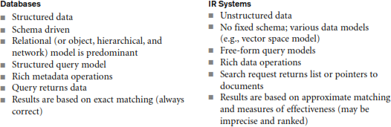
COMPARISON OF DATA

Slide 9
MODES OF INTERACTION
There are two main modes of interaction with IR systems
retrieval
browsing
Retrieval is concerned with the extraction of relevant information from a repository of documents through an IR query
Browsing signifies the activity of a user visiting or navigating through similar or related documents based on the user’s assessment of relevance. During browsing, a user’s information need may not be defined a priori and is flexible.

Slide 10
Ir processing
IR PROCESSING
Statistical approach
Semantic approaches
STATISTICAL APPROACH :-
IN THIS APPROACH , THE DOCUMENTS ARE FIRST ANALYZED AND BROKEN DOWN INTO CHUNKS OF TEXT.
EACH WORD IS COUNTED FOR ITS RELEVANCE.
THESE WORDS ARE THEN COMPARED AGAINST THE QUERY TO TEST THE SIGNIFICANT DEGREE OF MATCH.
BASED ON THIS MATCHING, THE RANKED LIST OF DOCUMENT CONTAINING THESE WORDS IS PRESENTED TO THE USER.
SEMANTIC APPROACH :-
IN THIS APPROACH THE KNOWLEDGE BASE TECHNIQUE OF INFORMATION RETRIEVAL IS USED
THE SYNTACTICAL,LEXICAL,SENTENTIAL,DISCOURSE BASED AND PRAGMATIC LEVEL OF WORDS ARE USED TO PREPARE KNOWLEDGE BASE FOR UNDERRSTANDING

Slide 11
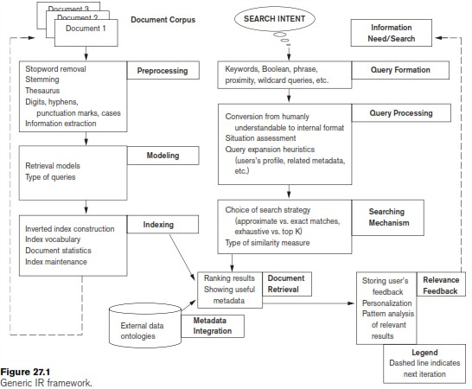
GENERIC IR FRAME WORK

Slide 12
GENERIC IR FRAME WORK
Figure shows a simplified IR processing pipeline. In order to perform retrieval on documents, the documents are first represented in a form suitable for retrieval. The significant terms and their properties are extracted from the documents and are represented in a document index where the words/terms and their properties are stored in a matrix that contains these terms and the references to the documents that contain them.
This index is then converted into an inverted index of a word/term vs. document matrix. Given the query words, the documents containing these words—and the document properties, such as date of creation, author, and type of document—are fetched from the inverted index and compared with the query. This comparison results in a ranked list shown to the user.
The user can then provide feedback on the results that triggers implicit or explicit query expansion to fetch results that are more relevant for the user. Most IR systems allow for an interactive search where the query and the results are successively refined.

Slide 13
Thank you
By tech cynics

